Slide 1
Framework for Facial Recognition-Based Institutional Presence Verification
NAME : VAIBHAV KUMAR MENTOR : DR. VIKAS TRIPATHI
SECTION : ML-1
ROLL. NO. : 45
UNIVERSITY ROLL. NO. : 2024132

Slide 2
INTRODUCTION
What is face recognition ?
Face recognition is a biometric technology that identifies or verifies individuals based on their facial features. It works by analyzing patterns and unique characteristics of a person's face, such as the distance between the eyes, nose shape, and jawline.
Application :
Security and Surveillance: Monitoring and identifying individuals in public spaces.
User Authentication: Unlocking devices or accessing systems securely.
Attendance Systems: Automating attendance in schools, offices, and other institutions.

Slide 3
PROBLEM STATEMENT
Framework for Facial Recognition-Based Institutional Presence Verification recognition by using python libraries.
Challenges Addressed :
Accessibility: Existing face recognition software often lacks ease of use and real-time capabilities.
Performance Optimization: Ensuring smooth webcam feeds and quick processing of data, especially when dealing with institutional datasets.

Slide 4
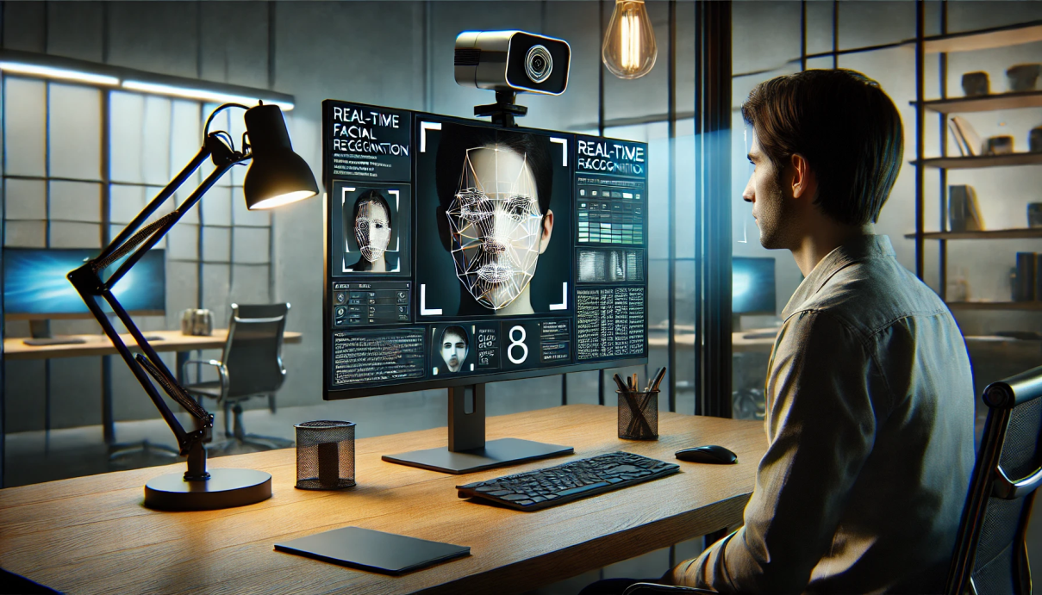
Methodology
System Overview:
Integration of a webcam to capture real-time video feeds.
Real-time face detection using the powerful face_recognition library.
Extraction of facial features and encoding for efficient comparison with stored data.

Slide 5
Methodology
Implementation Steps:
Capture Video Feed via Webcam:
Utilize webcam hardware to continuously capture video frames.
Implement a stable and high-resolution feed for accurate detection.
Detect Faces in the Frame:
Apply the face_recognition library to analyze each frame.
Locate and identify potential facial regions within the video feed.
Extract and Compare Facial Features:
Extract distinct facial landmarks and features from detected faces.
Convert these features into encodings for comparison against known data.

Slide 6
Methodology
Software Features
Dataset Matching:
Institutional Validation: Implement a mechanism to match recognized faces against a predefined institutional dataset.
Reporting: Generate reports on matches, including details about the matched individual and confidence levels.
Real-Time Recognition:
Optimized Processing: Ensure that the application can process video frames efficiently to maintain a smooth and responsive user experience.
Feedback Mechanism: Provide real-time feedback on recognized individuals, including alerts for recognized matches.

Slide 7
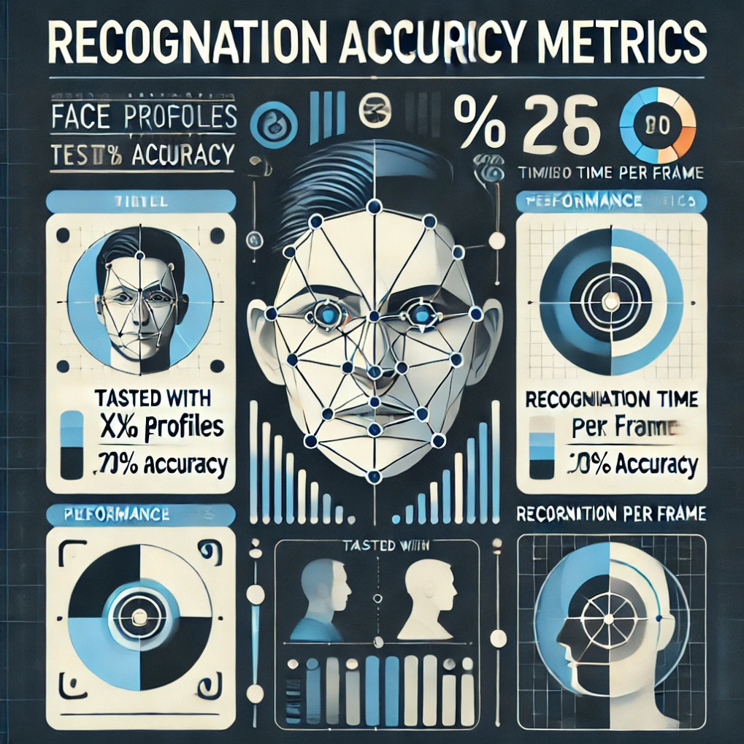
Results and Discussion
Recognition Accuracy Metrics
Profiles Tested:
Number of Profiles: [X] (Insert the actual number of profiles you tested with)
Accuracy Rate: [Y]% (Insert the actual recognition accuracy percentage)
Performance Metrics:
Recognition Time per Frame: [Z] ms (Insert the actual recognition time per frame)

Slide 8
Results and Discussion
Frame Rate (FPS):
Definition: Frame rate, measured in frames per second (FPS), indicates how many frames of video are processed by the system in one second. A higher FPS value generally results in smoother video playback and more responsive real-time applications.
Measurement: The FPS value can be calculated by measuring the time taken to process a certain number of frames.
Importance: Maintaining a high FPS is crucial for real-time applications, as it ensures timely detection and recognition of faces, leading to better user experience.

Slide 9
Results and Discussion
Effective Under Varied Lighting Conditions:
Definition: This metric assesses the system's ability to accurately detect and recognize faces under different lighting scenarios, such as bright sunlight, dim lighting, and mixed lighting environments.
Measurement: The effectiveness can be evaluated through tests where faces are captured in various lighting conditions, and the system's detection and recognition rates are recorded. This includes assessing false positives and false negatives across different settings.
Importance: The robustness of the system under varied lighting is essential for practical applications, as real-world environments can be unpredictable. An effective system will maintain high accuracy and reliability regardless of lighting changes.

Slide 10
Conclusion
Face Recognition System: The developed face recognition system recognizing individuals in real time.
Integrated Profile Management and Institutional Datasets: It integrates institutional datasets to ensure that recognized individuals can be effectively matched against specific groups, enhancing its applicability in organizational contexts.

Slide 11
FUTURE WORK
Future Work
Mobile Application Integration: There are plans to develop a mobile application that incorporates the face recognition functionality, allowing users to access the system on-the-go and expanding its usability across different devices.
Enhance Recognition Under Extreme Conditions: Future enhancements will focus on improving recognition capabilities under challenging conditions, such as low light, glare, or rapid movements, ensuring reliable performance in diverse environments.
Utilization of Advanced Neural Networks for Accuracy: To further improve accuracy, the system will explore the integration of advanced neural network architectures. These models are expected to enhance facial recognition capabilities, providing higher precision and reliability in various scenarios.

